Slide 1
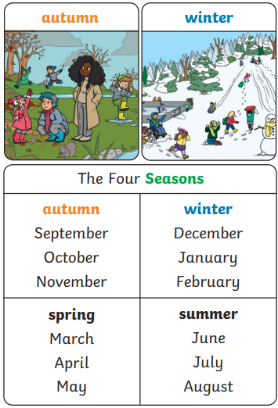
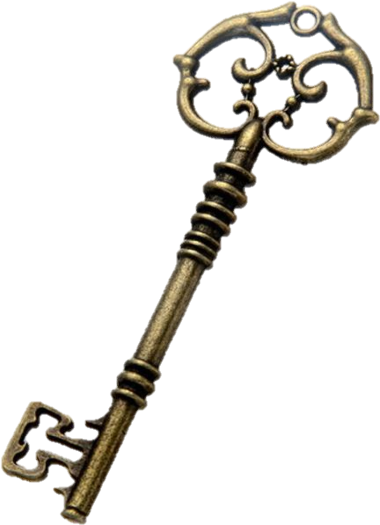
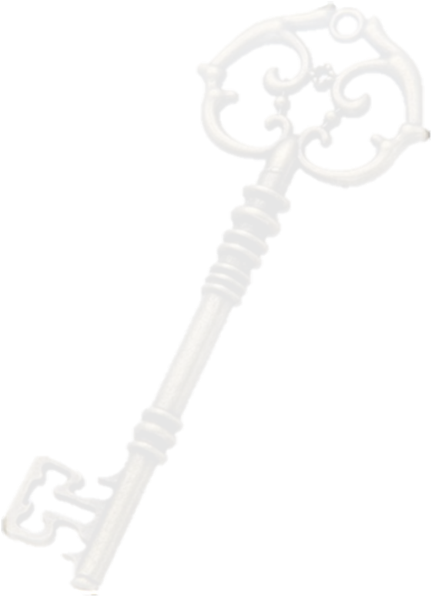
The ASPIRE Curriculum-Key Learning
Title: Seasonal Changes – Autumn and Winter Subject: Science Year: 1
Key Knowledge | Key Skills | Key Vocabulary
 | I can identify a season. I can name each of the four seasons. I can give examples of things that happen in the seasons. I can describe the changes seen between seasons. I can name some signs of Autumn. I can spot seasonal changes in my local area. I can describe the weather associated with Autumn and Winter. I can describe how things change in nature during Autumn and Winter. I can gather and record careful observations. I can make observations about the weather. | Seasons: In the UK, there are four seasons each year. They are spring, summer, autumn and winter. Autumn: In autumn, the temperature begins to get lower and it can be quite chilly and windy. It starts to get darker earlier in the day. Some animals get ready to hibernate and some types of trees lose their leaves. Winter: Winter is the coldest season of the year. It can be very rainy and windy and it might even snow. Not many flowers are in bloom during winter and lots of trees have lost all their leaves. Some animals hibernate during winter and many are less active than in the warmer months. Weather: The weather includes the temperature outside, how windy it is and rainfall (how much it rains). We can also describe cloud, snow and sun. Daylight: Daylight is when it is light outside. The amount of daylight changes with each season.

