Slide 1



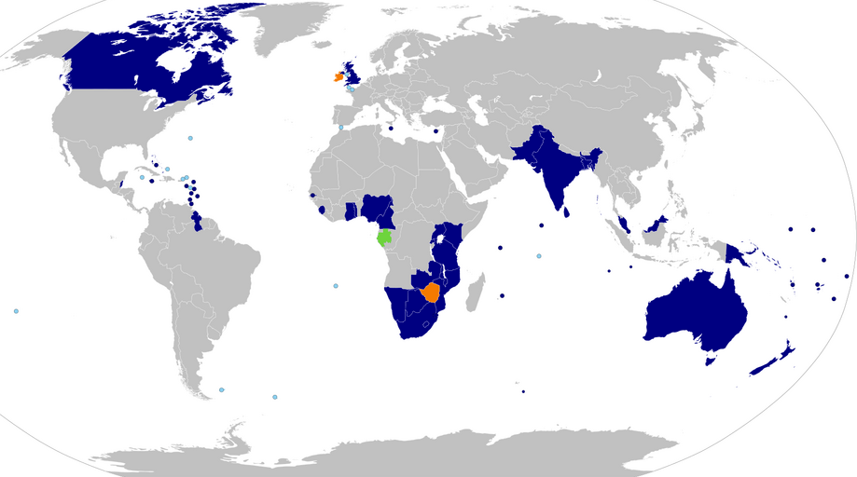
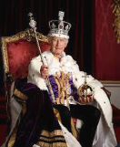
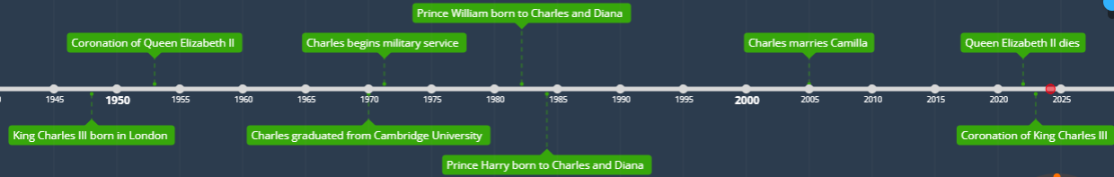
The ASPIRE Curriculum-Key Learning
Title: Who lives at Buckingham Palace? Year: 1 Subject: History
Key Knowledge | Key Skills | Key Vocabulary
 | • I can learn things that happened to myself and others in the past. • I can order a set of events with support from the teacher. • I can look at books, videos and pictures to find out about the past. • I can begin to ask questions about events, pictures and objects from the past.
Elizabeth II, Queen of the United Kingdom and the other Commonwealth realms, died on 8 September 2022 at Balmoral Castle in Scotland, at the age of 96. Elizabeth's reign was the longest of any British monarch.
Aged 73, King Charles III became the oldest monarch ever crowned in British history when his mother, Queen Elizabeth II passed away.
While serving in the military, King Charles III trained as a jet and helicopter pilot and became an accomplished diver.
King Charles III founded nearly 20 charities. Together, these charities raise £140 million each year for good causes!
HRH King Charles III | The current monarch who was coronated on 6th May 2023
HRH Queen Elizabeth II | The previous ruler of the United Kingdom and was the longest serving monarch ever of the United Kingdom
majesty | A royal person
monarch | A head of state, especially a king, queen, or emperor
Prince of Wales | The Prince of Wales is a title traditionally given to the male heir apparent (future king) to the English and, later, British thrones.
reign | The time/period that a person is in charge and rules over the country
Union Jack | The name of the flag of the United Kingdom (England, Scotland, Wales and Northern Ireland
The Commonwealth – King Charles III is King of 15 of these countries

