Slide 1
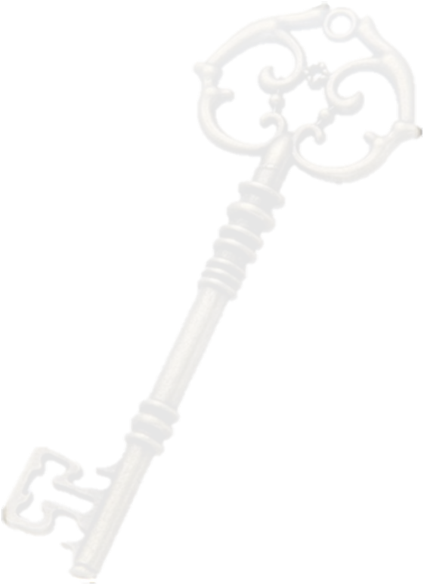
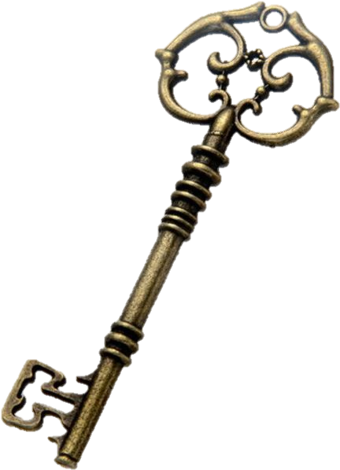
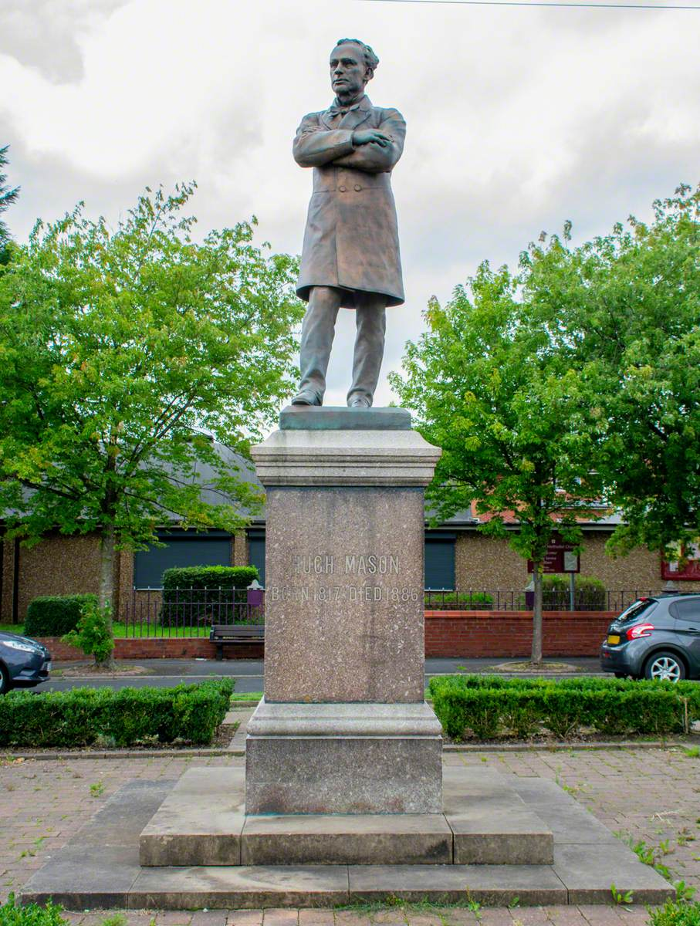
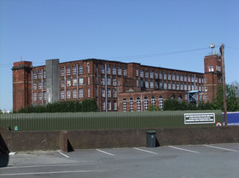
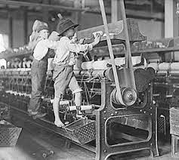
The ASPIRE Curriculum-Key Learning
Title: Who worked at the factory through our window? Year: 2 Subject: History
Key Knowledge | Key Skills | Key Vocabulary
 | • I can use the words past and present when describing events. • I can use eyewitness accounts, artefacts and the internet to find out about the past. • I can look at evidence to describe why people acted the way they did in the past. • I can begin to answer questions using a range of information sources.
The Guide Bridge Factory was once a cotton mill during the Victorian era where many people, including children, would work.
The living conditions of children in the past were very different from today. Not all children went to school. Some children would have to go to work to earn money for their families. They had to work in dangerous conditions that could cause problems with their health.
Hugh Mason worked with the local community to improve living conditions and make things fair for the people working in the Guide Bride Factory. A statue was made to remember the significance of him in improving the lives of our past relations.
Factory | A building where things are made in large numbers.
Cotton mill | A factory where cotton was made.
Child worker | A child who has to go out to work to earn money for their family.
Living conditions | The way people live and work that affects their safety, comfort and health.
statue | A sculpture of a person made of metal or stone.
Hugh Mason | A mill owner and politician who made better working conditions for the people in Ashton-Under-Lyne
Victorian | During the reign of Queen Victoria.

