Slide 1
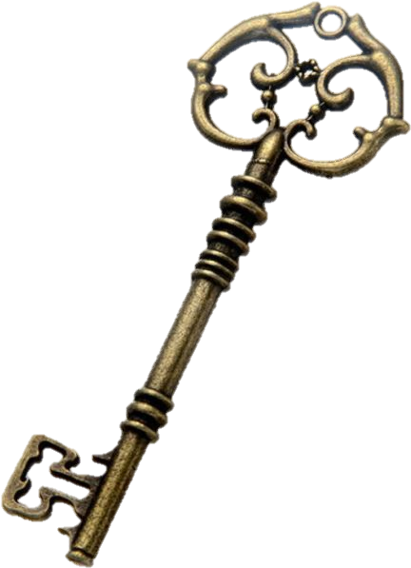
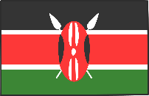
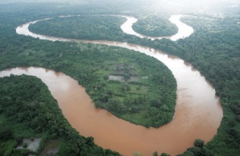
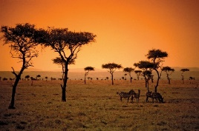
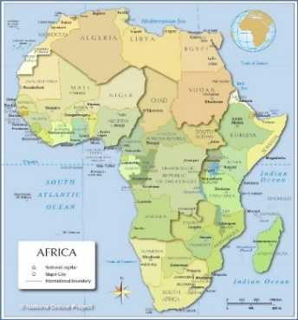
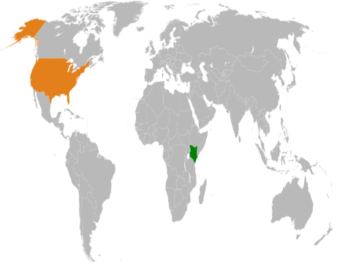
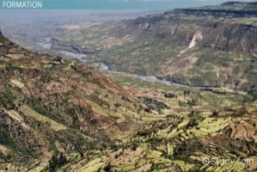
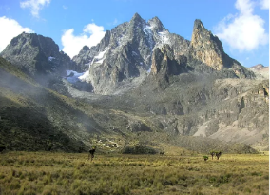
The ASPIRE Curriculum-Key Learning
Title: What is it like to live in Kenya? Year: 2 Subject: Geography
Key Knowledge | Key Skills | Key Vocabulary
 | I can locate places on maps, atlases and globes. I can compare two places. I can observe and record the weather and temperature in different places. I can ask and answer geographical questions. I can study pictures of two contrasting localities. I can use geographical vocabulary to describe places. I can use directional and locational language to describe places.
 | Comparison
Country | Kenya | England
Continent | Africa | Europe
Flag
Important river/lake | The Great Rift valley Tana River | River Thames
Mountain | Mount Kenya | Scafell Pike
Population | 51 million | 56 million
Climate | Wet and dry seasons Dry and warm Rainy season | Summer: warm, sunny Winter: cold, wet. Sometimes snows
agriculture | The work of raising crops and farm animal
capital city | A city that has been identified as the location for the government.
climate | The usual weather conditions in a place.
coast | The land next to the ocean
continent | A large land mass. There are 7 continents in the world.
Equator | The imaginary circle around the earth that is halfway between the North and South Poles.
hemisphere | A hemisphere is formed by dividing the earth into the Northern and Southern Hemispheres at the equator,
highlands | A part or region of a country that has many hills or mountains.
lowlands | Land that is lower than the land around it.
population | The people who live in an area.
savannah | A flat plain covered with grass and few trees. Savannas are found in Africa and other tropical regions.
tribe | A group of people or villages that share the same language and traditions.
tropical | Land or area that is near the Equator.
tourist | A person who travels to different places.
Tana River
Kenyan savannah
Map of Kenya and the UK Africa
Physical geography
The Great Rift Valley
Mount Kenya

