Slide 1
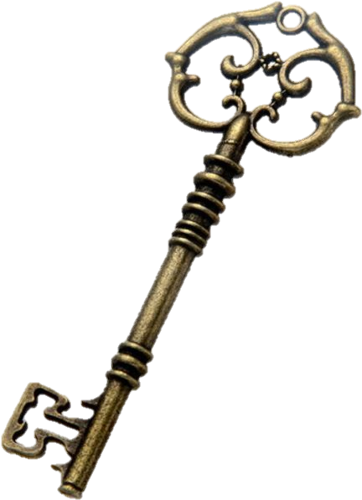
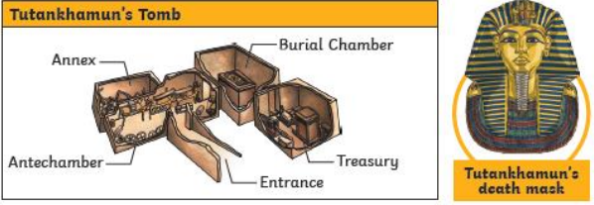
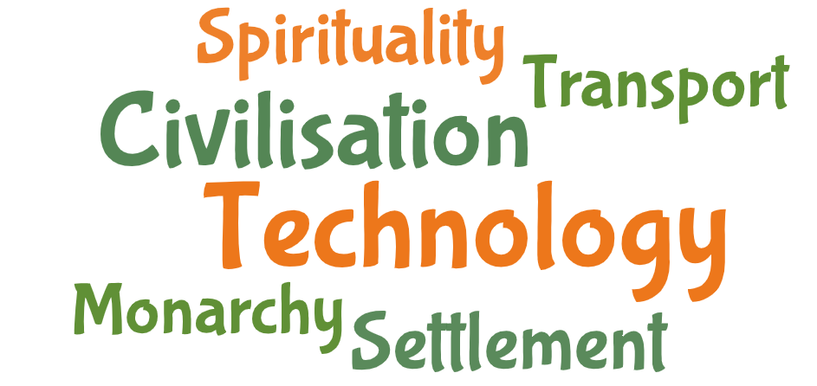
The ASPIRE Curriculum-Key Learning
Title: What did the Ancient Egyptians achieve and believe? Year: 3 Subject: History
Key Knowledge | Key Skills | Key Vocabulary
 | • I can identify iconic images of Ancient Egyptian culture. • I can name four ancient civilizations and explain how they were similar. • I can explain how Egyptian society was structured. • I can locate the Nile valley and explain why it was so important to the Egyptian people. • I can identify how Egyptian writing helps us understand their culture.
Hieroglyphs were written by scribes, who had to go to a special school to learn how to write. Almost all scribes were men, although there is some evidence of female doctors being able to read hieroglyphs in medical texts.
The Rosetta Stone, discovered in 1799, was written in hieroglyphs and two other languages, including ancient Greek, which linguists (language experts) could still read.
The river Nile was essential to life in ancient Egypt. Every year, it flooded, leaving behind a black silt that enriched the soil for growing crops. The river was also used to irrigate fields in other areas.
Most people lived along and around the Nile. This is still true in Egypt today. The river was used for water, fishing and trade. Mud from the river was used for bricks and papyrus plants were used to make paper.
BC | Used to show that a date is before the year 0. This is counted backwards, so 200 BC is before 100 BC.
AD | Used to show that a date is after the year 0. This is counted forwards, so AD 100 is before AD 200.
irrigation | A system of canals or channels Egyptians dug to supply water to grow crops over a larger area than the water would reach naturally.
silt | Fine particles of soil, clay or sand carried and left by water.
hieroglyphics | A system of writing that used pictures and symbols (hieroglyphs) instead of letters.’
cartouche | An oval shape in which the names of kings and queens were often written in hieroglyphics to show that they were special.
pharaoh | A ruler of ancient Egypt.

