Slide 1
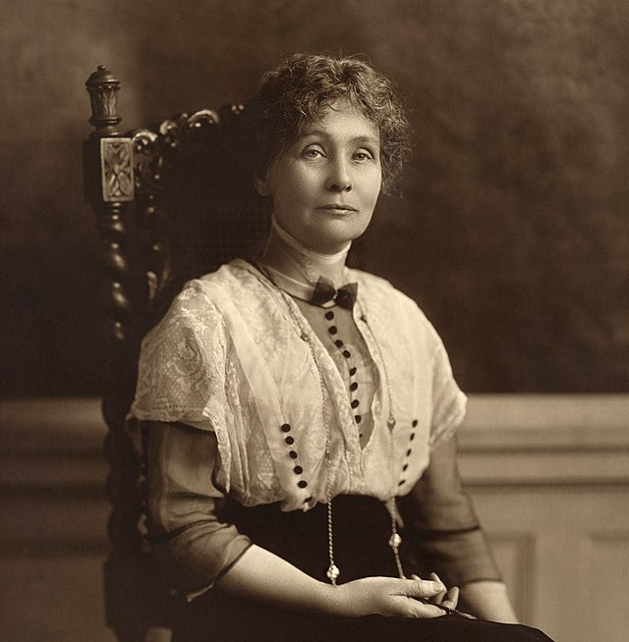
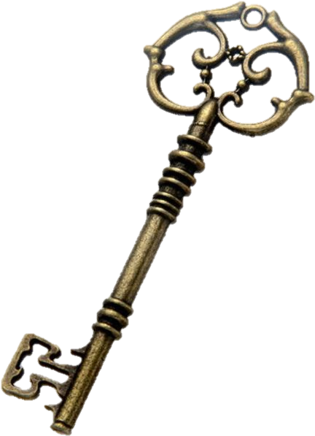
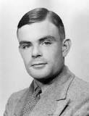
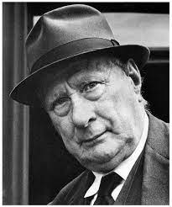
The ASPIRE Curriculum-Key Learning
Title: How can the history of Manchester inspire us? Year: 4 Subject: History
Key Knowledge | Key Skills | Key Vocabulary
 | • I can describe similarities and differences between people, events and artefacts studied. • I can know that some things from the past still affect our lives today. • I can use independent research to ask and answer questions about the past. • I can research two versions of the same event and say how they differ.
Emmeline Pankhurst was born in Manchester in 1858. She fought hard for equal voting rights for women. She made powerful speeches asking women to join her protests.
artificial intelligence | The ability for a computer to think and learn
decoding | Converting a coded message so it can be understood.
gallery | A room or building for exhibiting works of art
legacy | Something that happened in the past or that comes from someone in the past
politics | A set of beliefs about the laws and things going on in the place where you live
suffrage | The right to vote in political elections
urban | Having to do with a city or town
Alan Turing designed a code-breaking machine known as the Bombe. They used the Bombe to learn German military secrets which helped war efforts in World War 2.
LS Lowry, was an artist who lived in Manchester and was inspired by his surroundings and the events in his life. He was born in 1887, and his family first lived in an area outside of the city. They eventually moved to a more urban area

