Slide 1
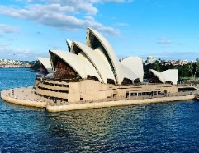
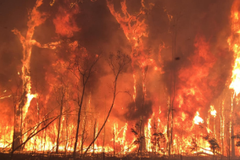
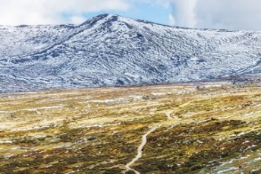
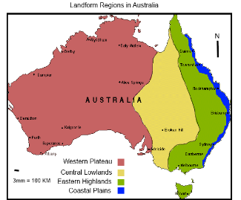
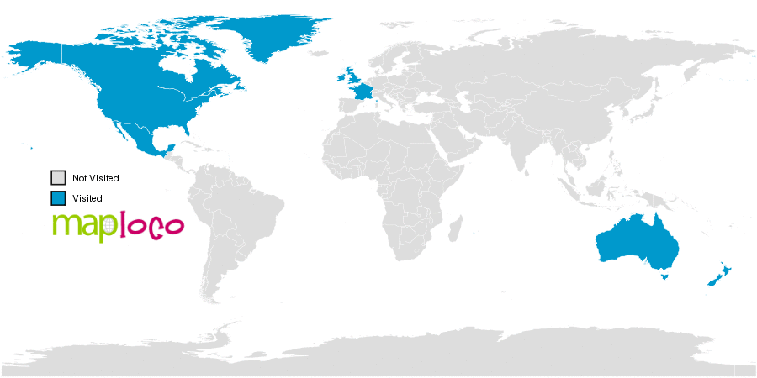
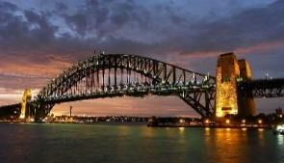
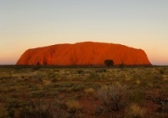
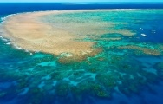
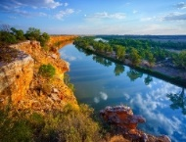
The ASPIRE Curriculum-Key Learning
Title: What is it like to live in Australia? Year: 4 Subject: Geography
Key Knowledge | Key Skills | Key Vocabulary
 | I can use 8 compass points to locate places. I can use maps, globes and atlases to locate places. I can use geographical vocabulary to describe and compare locations. I can ask geographical questions. I can use 4 figure grid references to locate places on a map. I can describe the human and physical features in different locations.
 | Comparison
Country | Australia | England
Continent | Australia/Australasia/Oceania | Europe
Flag
Important river | Murray River | River Thames
Mountain | Mount Kosciuszko | Scafell Pike
Population | 24.9 million | 55.9 million
Climate | Different climate in the North to the South of Australia High temperatures all year round. Hot and dry, little rain Seasons are opposite to the UK | Summer: warm, sunny Winter: cold, wet. Sometimes snows
Aboriginal | Native to a land or area.
arid | An arid climate is hot and dry.
climate | The usual weather conditions in a place.
coral reef | A mound or ridge of coral that forms in warm, shallow sea waters.
ecosystem | A community of living things, together with their environment.
hemisphere | A hemisphere is formed by dividing the earth into the Northern and Southern Hemispheres at the equator.
indigenous | Originating in a country or locality.
landform | A natural feature of the Earth’s surface.
outback | The isolated, rural country in Australia.
plateau | A large area of flat and level land.
population | The people who live in an area.
temperate | A temperate climate is milder in temperature and rainfall and experiences all four seasons (spring, summer, autumn and winter).
tropical | A tropical climate has two seasons: wet and dry
Map of Australia and UK
human geography
physical geography

