Slide 1
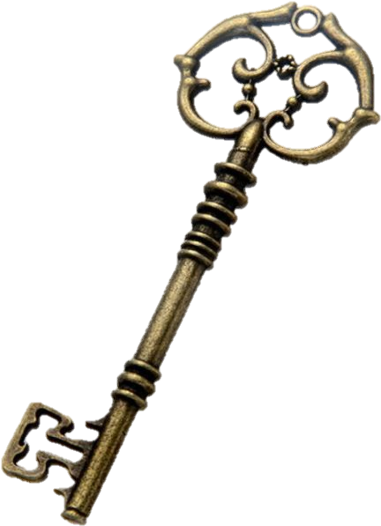
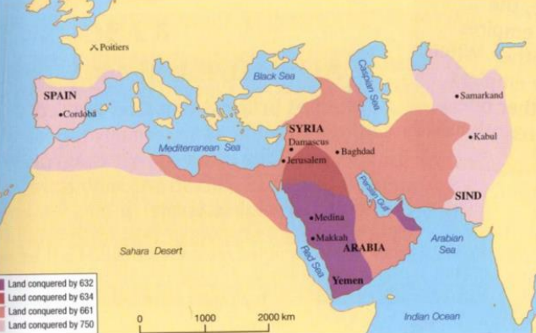
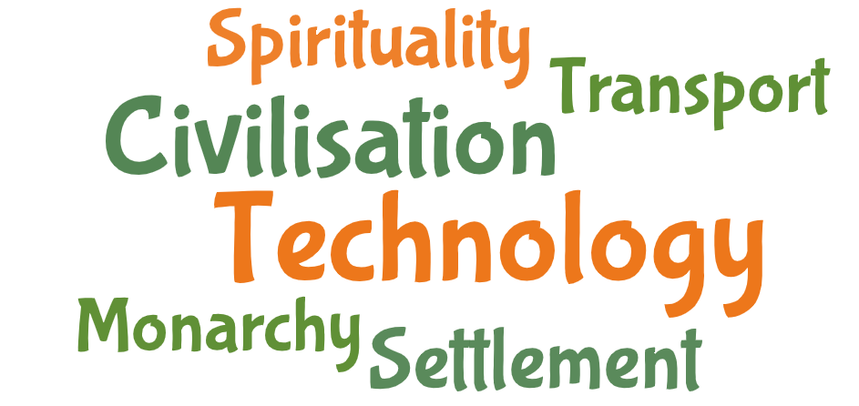
The ASPIRE Curriculum-Key Learning
Title: What did early Islamic civilisation leave behind? Year: 5 Subject: History
Key Knowledge | Key Skills | Key Vocabulary
 | • I can place periods of history on a timeline showing periods of history. • I can evaluate evidence and choose most reliable forms. • I can make links and comparisons between features of past societies. (e.g. religion, houses, technology) • I can use reliable sources of information to answer questions- realising there is often not a single answer
The Islamic Empire flourished with trade, invention and innovation.
Baghdad was a round city. It was built like this so that everywhere was the same distance from the Caliph at the centre. This was also where all the important buildings were.
Caliph was extremely wealthy. The rich had access to many of the luxuries we do today: libraries, schools, a wide variety of international food and well-lit streets due to links with other countries.
Baghdad was the largest city in the world, with a population of 1 million. It was the centre of culture and learning, one reason why it was named The Golden Age of Islam.
The House of Wisdom was found in Baghdad, a place where classical works were translated into Arabic. It was at the forefront of medicinal, mathematical and scientific advancements of the age.
From an Islamic perspective health is viewed as one of the greatest blessings that God has bestowed on mankind; improving medicine and pursuing cures for ailments was seen as a duty of faith
AD | AD is used to show dates after the birth of Jesus.
caliph | Spiritual leader of Islam, former Muslim rulers of Baghdad.
caliphate | The land ruled by a Caliph.
conquer | to get/gain by force; to win by fighting.
empire | a large area made up of different societies all ruled by one leader.
mosque | a place of worship for
Silk Road | a network of historical trade routes that connected China and the Far East with countries in Europe and the Middle East.
trade | the action of buying and selling goods or services.

