Slide 1
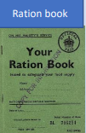
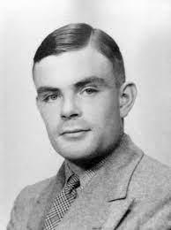
The ASPIRE Curriculum-Key Learning
Title: How did Manchester help to end World War 2? Year: 6 Subject: History
Key Knowledge | Key Skills | Key Vocabulary
 | • I can explain the term appeasement and show I understand how World War II started. • I can understand what the Blitz was and how it affected my local area. • I can explain what evacuation was and how it affected children during World War II. • I can explain what rationing was and what it meant for British people. • I can interpret and evaluate the reliability of sources.
After the loss of WWI in 1918, Germany’s economy has suffered. In 1934, the people voted for Hitler, the leader of the Nazi party to lead them after he had offered them hope.
It wasn’t just London that was subject to bombing. Other industrial cities were also targeted although none as badly as London.
Hitler sent the Luftwaffe bombers to attack British ports and RAF airfields.
Many children in urban areas were moved temporarily from their homes to places considered safer, usually out in rural areas of Britain.
Manchester and the surrounding area was a major centre of industry during the Second World War. Many large firms were concentrated in the Trafford Park area, making it an important target for German bombers.
Alan Turing played a key role in breaking German naval codes including the famous Enigma machine – this without doubt saved many lives and may even have shortened the war by up to 2 years.
Chamberlain (Neville) | Prime Minister of the United Kingdom from 1937 to 1940
Churchill (Winston) | Prime Minister of the United Kingdom from 1940 to 1945.
defend | Take action in order to protect something
economy | A country’s economy is the wealth that it gets from business.
evacuate | To evacuate someone means to send them to a place of safety
Hitler (Adolf) | Leader of the Nazi Party from 1934 to 1945.
industry | The work and processes involved in collecting raw materials, and making them into products in factories.
invasion | To try and take over a place by force.
Luftwaffe | The German Air Force
military | Relating to or belonging to the army.
Nazi | A member of the far-right political party in Germany.
rationing | The system of limiting the amount of food, water, petrol, or other substances when there is not enough of them
surrenders | Stop fighting or resisting someone.
Alan Turing

